Slide 1
Java Lab Assignment #2 Convert a string into an integer in relation to a phone keypad – Nicholas Carroll – 12 November 2018

Slide 2
Analysis – what is known and given?
Before we even think about coding specifics, we have to determine the objective (this is the first step used in an IPO diagram [input-process-output diagram]).
If the user inputs a string character like ‘A’, the program should return an integer that tells the user where that character would be on a phone keypad.

Slide 3
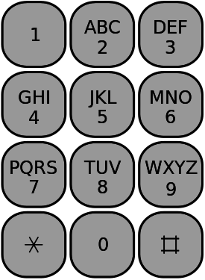
Example
The image shows how the strings “ABC” should correspond to the integers “1”

Slide 4
Analysis cont.
There are multiple ways to create a program like this, I used the switch → case/break (Java Lesson 3B) operation.
Instead of using a ridiculous amount of if…else statements, we can test a variable against a large amount of conditions or “cases”, the program will execute under each condition and “break” when code for each condition is broken.
Finally, we must consider that if the user types a lowercase letter, we can use a method that will automatically convert the input to uppercase.

Slide 5
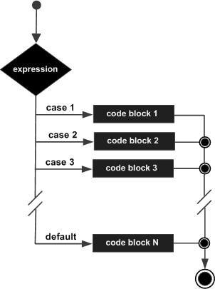
Example
Visualization of the switch → case/break operation.

Slide 6
Test Cases
Test Case 1:
“Enter a letter to convert from string to integer: “
Input: A
Output: “The corresponding number is 1”
Test Case 2:
“Enter a letter to convert from string to integer: “
Input: a
Output: “The corresponding number is 1”

Slide 7
Algorithm
Create the package, import the Scanner class and define the class and main method.
Create all the necessary Scanner and String objects such as input and letter respectively.
Initialize them to allow user input and to convert their input automatically to uppercase using String class methods.

Slide 8
Algorithm cont.
Using the letter variable, create a switch block as shown below:
switch (letter) {
case "A" :
case "B" :
case "C" : System.out.println("The corresponding number is 2");
Break all cases corresponding to each letter. End the switch block, main method and class only if no other submethods are used.

